Slide 1
Vocera Analytics 1.0 Technical Review
Target audiences: TAMs, TSEs, IEs, SEs
Jim Kesterson, Lead Technical Learning Consultant
March 12, 2018
Notes:
[Click anywhere to advance to next slide]

Slide 2
Course Goal
Receive a technical overview of key procedures, features, and functionality
Let you know where to find details
Notes:
This course will give an overview of
Also be letting you know where to find complete lists and documentation.

Slide 3
Introduction to Vocera Analytics 1.0
Notes:
First, let’s talk about at a high level.
[Click anywhere to advance to next slide]

Slide 4
Module Objectives
After this module, you should be able to:
Describe what Analytics is
Describe benefits for Vocera and customers
Launch the Introduction to Vocera Analytics 1.0 course
Identify location of Vocera Analytics overview documentation
Notes:
[Click anywhere to advance to next slide]

Slide 5
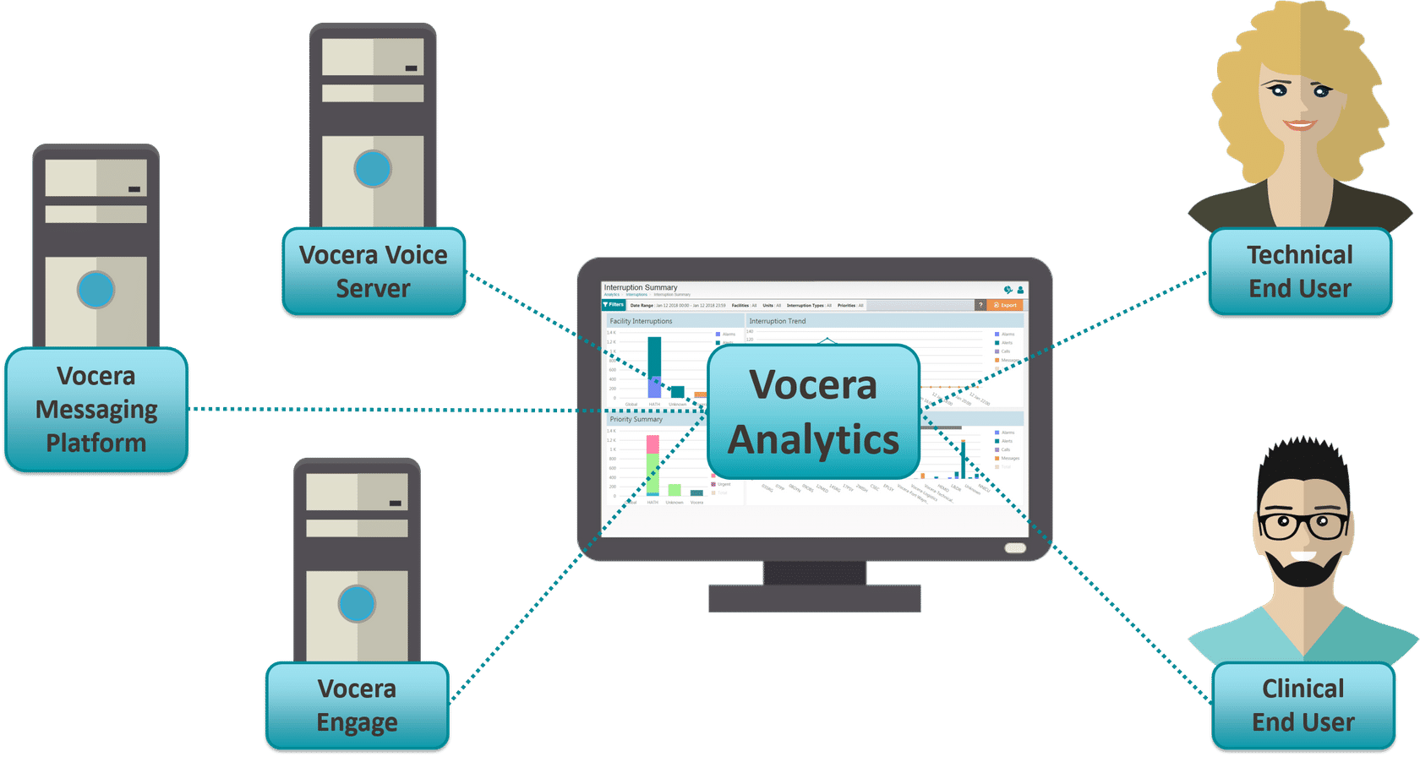
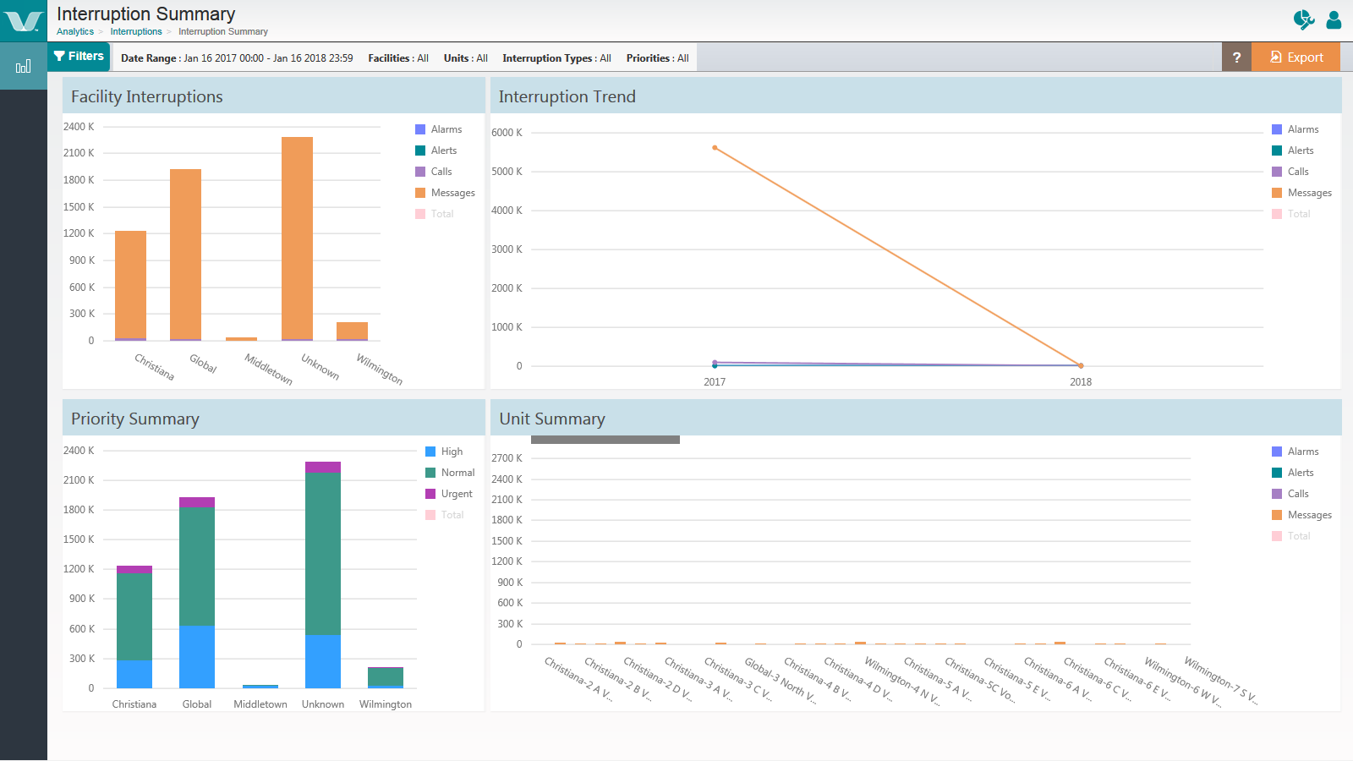
What is Vocera Analytics?
Reporting
Notes:
Vocera Analytics is the newest reporting offering from Vocera. [first image will stay up for 5 seconds, then other image will take over]
It consolidates data from VS, VMP, and Engage into a single platform, providing a unified communication view available through a modern web-based user interface.
It improves upon and will eventually replace reporting from the existing systems.

Slide 6


What is Vocera Analytics?
Reports and Dashboards
Enable ad-hoc reporting
Interactive, including drill down
More summary-type info
Pie charts or graphs
Dashboards
Integrated with Crystal Reports, like VRS
Can be scheduled and emailed
More detailed
Not interactive – no drill down
No pie charts or graphs
Reports
Notes:
The front-end consists of reports and dashboards. [click anywhere to bring in dashboards]
Dashboards enable ad-hoc reporting, they’re interactive, and you have the ability to drill down into the data. They’re really more for summary information. They provide the nice look of a pie chart or graph so that information jumps out at you.
And then there are also reports.
Click anywhere to bring in reports
Reports are integrated with Crystal Reports, as is the Vocera Reporting Server. Customers like the fact that they can be scheduled and emailed to the people who need to receive the information. They’re much more detailed but you cannot “drill” into the information. They also don’t contain graphics, charts, or interactivity.
Some dashboards provide identical detail for reports. It will really just boil down to what format they want.

Slide 7

Benefits
Reporting provides information on:
  The health of the system
  Device tracking
  Post-deployment assessment – how well are end users doing?
Business tool AND clinical tool
Notes:
Vocera Analytics reporting provides information about the health of their system, it tracks their devices, and even helps us during a post deployment assessment to see how well the end users are doing with the tool.
And it’s a business tool as well as a technical tool. Technical administrators can run licensing reports, voice reports or new speech recognition or license dashboards
clinical nurse managers can view interruption dashboards where they can see what types of alerts, alarms and even call volumes their staff is experiencing and responding to during their workday. This can be invaluable in determining things like staffing needs or assignments.
The Ad-hoc reporting capability enables users to run small short reports using dashboards versus having to schedule or filter thru pages and pages of data.
And of course the Reports can still be run, scheduled, and distributed for system administrators to share with the management as needed.

Slide 8


More Overview Information
      Introduction to Vocera Analytics 1.0 in EduBrite
      Describe what Vocera Analytics is and why it is being released
      Describe the key features of Vocera Analytics
      Explain how Vocera Analytics will benefit target customers
      Explain how Vocera Analytics will be positioned to customers
      Identify where to access help documents and procedures
      Vocera Analytics Overview in http://pubs-staging 01/

Slide 9
Hardware, Software, and Port Requirements
Notes:
Let’s take a quick look at hardware and software requirements. This is well documented, so I’ll just point out a few thing.

Slide 10
Module Objectives
After this module, you should be able to:
List the required software for a Vocera Analytics installation
List the deployment size options
Describe where to locate hardware, software, and port requirements
Notes:
[Click anywhere to advance to next slide]

Slide 11

Software Requirements – Vocera Products
Vocera Voice Server version 4.4.4 and later
Engage Platform version 5.5 and later, with EMDAN version 1.9x and later
Vocera Messaging Platform version 5.2.1 and later
Notes:
As far as Vocera products go, this is the required software.
You’ll need some third party software as well.
Click anywhere.

Slide 12

Software Requirements – Third Party
Crystal Reports 2016
  DO NOT install on the same machine as Vocera Analytics Server. Vocera Analytics Server has not been certified to work on computers where Crystal Reports Server is also installed.
MySQL Connector/ODBC 3.51 driver
  You must also set up an ODBC data source.
Notes:
As you can see, Crystal Reports 2016 is required and please note the cautionary statement here – don’t install this on the same machine you’ll be installing Vocera Analytics.
Click anywhere.
MySQL Connector/ODBC 3.51 driver is required, along with an ODBC source.

Slide 13
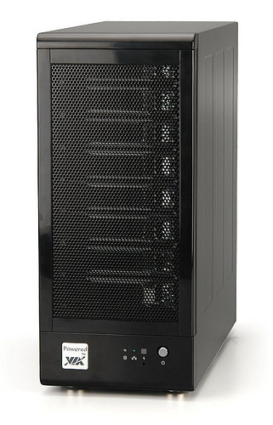
Sizing and Hardware Requirements
Hardware requirements depend on the number of users, beds, alarms, alerts, and calls
Small, medium, and large deployments
Access this information via Hardware Requirements page in the Vocera Analytics Administration Guide.
Notes:
Hardware requirements will vary depending on the size requirements.
There are 3 deployment sizes: small, medium, and large.
You’ll find tables with information in the Port Requirements page of the Admin Guide.
Click the link if you want to show them the tables.

Slide 14
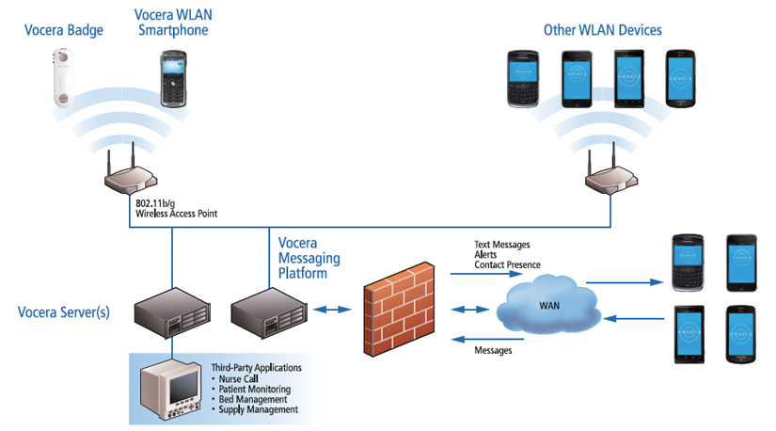
Port Requirements
Configure communication protocols and port numbers within the organization’s network environment.
Access the port descriptions, protocols, and numbers via the Port Requirements page of the Vocera Analytics Administration Guide.
Notes:
You’ll also need to configure communication protocols and port numbers within the organization’s network environment.
You’ll find tables with information in the Port Requirements page of the Admin Guide.
Click the link if you want to show them the tables.

Slide 15
Installation and Configuration
Notes:
Next, let’s talk about installation and configuration. I’ll point out some of the key steps and tell you where to find the procedure.

Slide 16
Module Objectives
After this module, you should be able to:
Identify where to find the installer
Indicate on which server to install Vocera Analytics
Identify where to find the installation procedure
Describe how to validate a successful installation
Notes:
[Click anywhere to advance to next slide]

Slide 17
Installing Vocera Analytics Suite 1.0.0
Obtain the VoceraAnalyticsInstaller.exe from SalesForce
Should be installed on the Voice Server
Run as administrator to launch the installer
Progress through the InstallShield Wizard
Access the full procedure via the Installing Vocera Analytics page
Notes:
These are the initial steps to installing. You can access the full procecure here via the Installing Vocera Analytics page.
Click the link if you want to show the procedure.

Slide 18
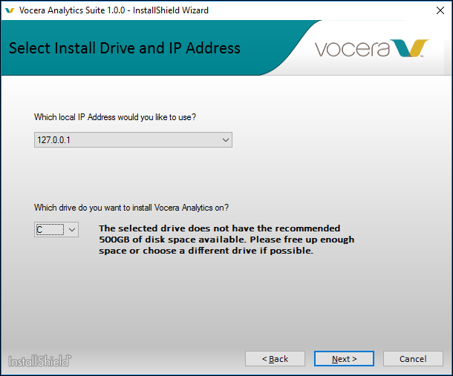
Select Install Drive and IP
Choose a local IP address and drive
Installer logs: <Vocera Analytics Install Drive>:\InstallLogs-Vocera\VoceraAnalytics\<version>
Notes:
You choose the local IP address and drive, and the installer logs will be installed in this path.

Slide 19
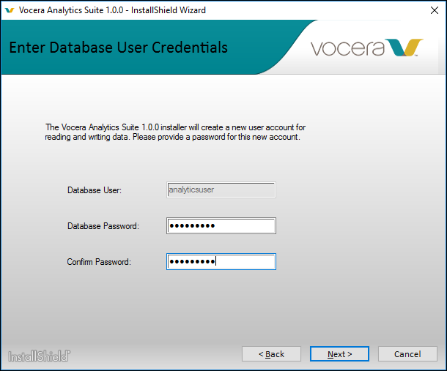
Create a New User Account for the DB
Notes:
Here you’ll create an account and password that will enable reading and writing data.

Slide 20
Installing the Remote Agent
You must install the remote agent in order to run the monitoring service.
When you run VoceraAnalyticsInstaller.exe, it will also install the remote agent on the Voice Server.
Installed on the same drive as Voice Server
The installer logs are stored in <Voice Server Install Drive>:\InstallLogs-Vocera\VoceraAnalytics\<version>
Notes:
The remote agent is part of the suite and it’s required in order to run the monitoring services. The installer executable will also install the remote agent on the Voice Server.

Slide 21
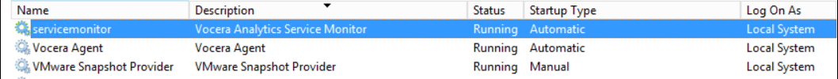
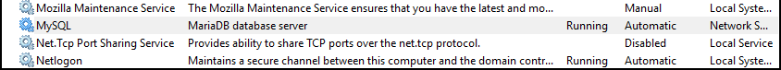
Validate Services after Installation
Use services.msc to check if the service monitor and MySQL services are installed and running; this will a successful installation.
Notes:
As you can here, you can use services.msc to validate a successful installation by making sure these services are running.

Slide 22
Migrating Data
Notes:
Next, we’ll talk about migrating dimensions and data from VS, VRS, VMP, and Engage.
[Click anywhere to advance to next slide]

Slide 23
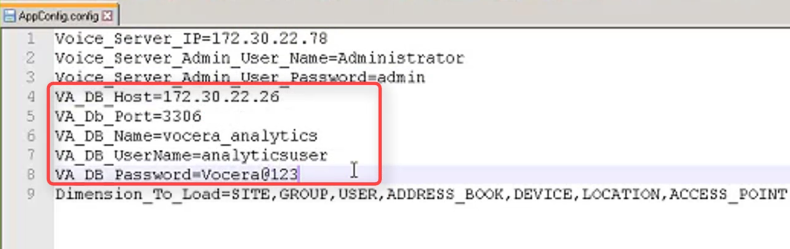
VS Dimension Loading: Edit the .config File
\VoceraAnalytics\DimensionLoading\AppConfig.config
  Enter source IP addresses, DB Info
Notes:
You can see in the last line of the AppConfig config file that dimensions refer to site, group, user, etc. This information needs to be migrated over from the Voice server.
You’ll need to modify this config file as shown. It’s located in the DimensionLoading folder.

Slide 24
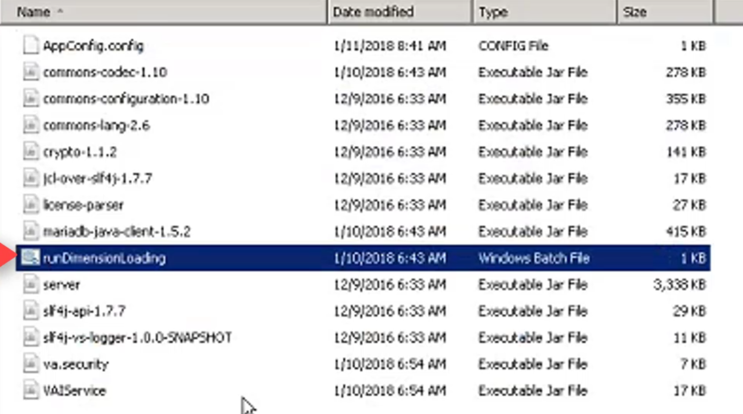
VS Dimension Loading: Run the Batch file
\VoceraAnalytics\DimensionLoading\RunDimensionLoading
Notes:
Next, you’ll want to run the batch file in the same folder.

Slide 25
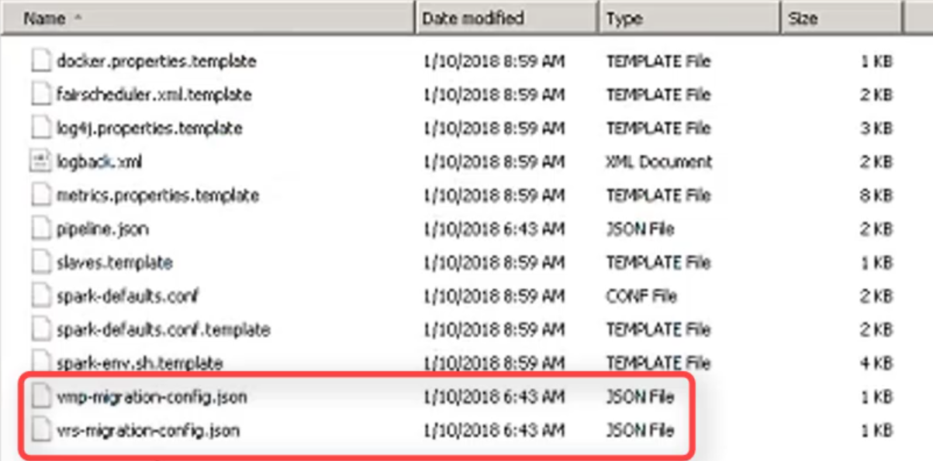
VRS/VMP Data Migration: JSON Files
\VoceraAnalytics\AnalyticsServer\conf\vrs-migration-config.json
Notes:
After migrating the dimensions, you need to migrate the data from VRS and VMP using the JSON files. You need to edit the source and target of these files.

Slide 26
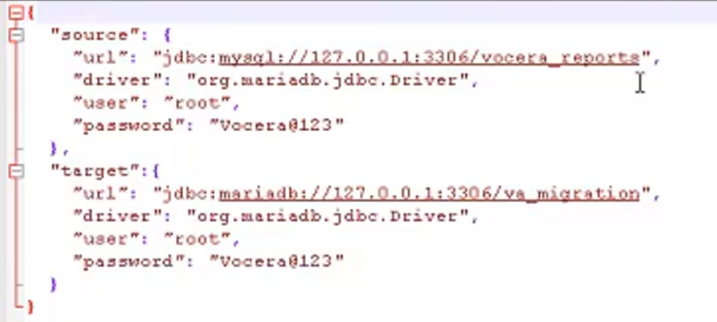
VRS/VMP Data Migration: Editing the JSON File
\VoceraAnalytics\AnalyticsServer\conf\vrs-migration-config.sjon
Notes:
This is what the file looks like, and what you’ll need to modify.

Slide 27
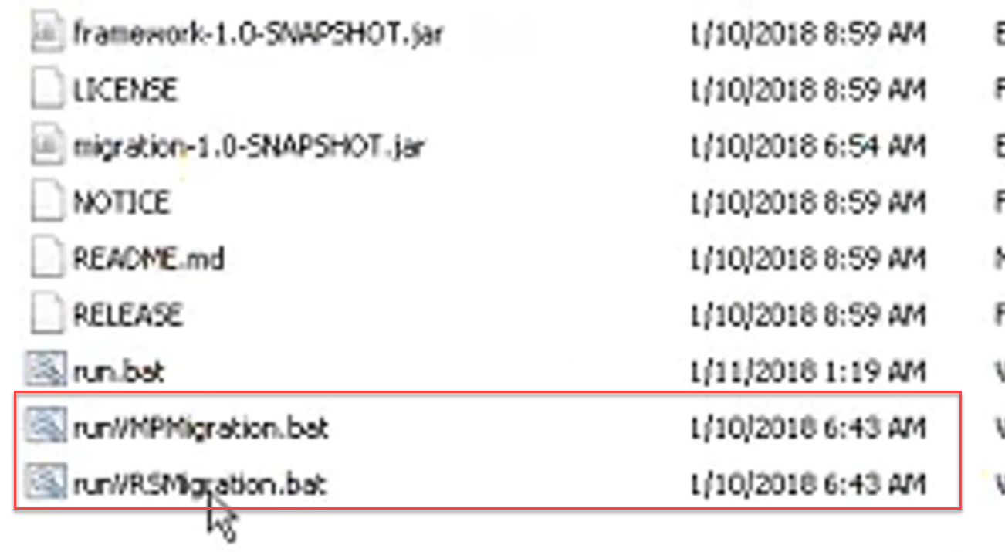
VRS/VMP Data Migration: Run the Batch file
\VoceraAnalytics\AnalyticsServer\runVRSMigration.bat
Notes:
There are two batch files: one for VRS and one for VMP. After running a batch file, the data from the respective server will migrate over into Vocera Analytics.

Slide 28
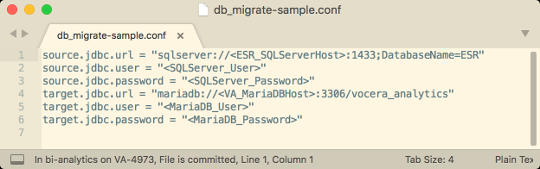
Engage Data Migration: db_migrate-sample.conf
migrate.cmd script: requires two .conf files to be configured
\VoceraAnalytics\DataMigration\db_migrate-sample.conf
Save as db_migrate.conf so migrate.cmd will read it
Edit the file with the appropriate URLs, user names, and passwords.
Detailed instruction in the Wiki: Vocera Analytics - Data Migration for Legacy Deployments
Notes:
For Engage migration,. There are 2 .conf files that you’ll need to modify before running the migrate.cmd command file. The first one is db_migrate-sample.conf.
These conf files are located in the in the DataMigration folder. As with the previous products, you need to modify the URLs, user names, and passwords. You’ll need to save it as db-run.conf,

Slide 29
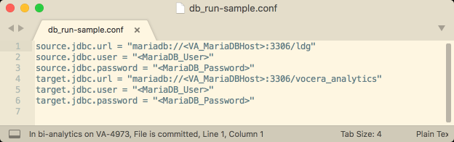
Engage Data Migration: db_run-sample.conf
migrate.cmd script: requires two .conf files to be configured
\VoceraAnalytics\DataMigration\db_run-sample.conf
Save as db_run.conf so migrate.cmd will read it
Edit the file with the appropriate URLs, etc.
Notes:
The other conf file is db_run-sample.conf. As you can see from the image, this one relates to the MariaDB information. You’ll need to modify this one as well, and save it as db-run.conf

Slide 30
Engage Data Migration: Execute migrate.cmd
\VoceraAnalytics\DataMigration\migrate.cmd
Save as db_run.conf so migrate.cmd will read it
Edit the file with the appropriate URLs, etc.
Notes:
This is what the file looks like, and what you’ll need to modify.

Slide 31
Assessment & Evaluation
You will automatically be enrolled in the course session in Edubrite.
Please complete the assessment to receive credit for attending this webinar
Please complete the course evaluation to provide feedback on the course content and the presenter to help us better serve you!

Slide 32
Thank you!

